Slide 1
Inferential Statistics

Slide 2
Outline
Introduction
What is Inferential Statistics?
Comparing Inferential and Descriptive Statistics
What is a Sample and a Population?
Common Inferential Tests
T-test
ANOVA
Chi-Square
Correlation

Slide 3
What is Inferential Statistics?
Test whether the patterns that you observe in a sample dataset are likely to be present in the broader population or whether those patters are a product of chance.

Slide 4
What is Inferential Statistics?
Inferential statistics is a branch of statistics that makes the use of various analytical tools to draw inferences about the population data from sample data.
While descriptive statistics summarizes the features of the data set, inferential statistics helps to draw conclusions about the population.

Slide 5
What is Inferential Statistics?
Inferential statistics can be defined as a field of statistics that uses analytical tools for drawing conclusions about a population by examining random samples.
The goal of inferential statistics is to make generalizations or reasonable guesses about a population.

Slide 7
Inferential and Descriptive Statistics
Descriptive | Inferential
Organizing and summarizing data using numbers and graphs | Using sample data to make an inference or draw conclusion of the population
Bar Graphs, Histograms, Pie Charts | Uses probability to determine how confident we can be that the conclusions we make are correct
Measures of Central Tendency: Mean Median and Mode | Confidence Intervals and Margin of Error
Measures of Variability: Range, Variance and Standard Deviation

Slide 8
Inferential and Descriptive Statistics
Descriptive | Inferential
Summarize and organize the data with the sample | Use the sample data to make inferences about the population

Slide 9
Inference
The process of drawing conclusions about population parameters based on a sample taken from the population.

Slide 10

Population and Sample
The population is the entire group we want to study
A sample is a small part of the population.
Sample
Population

Slide 11

Population
The population is all the mangoes in an orchard

Slide 12

Population
Sample
The sample is 10 mangoes we pick in an orchard

Slide 13


Slide 14


Slide 15
The population is all the voters in the Philippines
Population

Slide 16

Population

Slide 17
Population
Sample
A sample is 100 people who are asked their opinion in an online survey

Slide 18
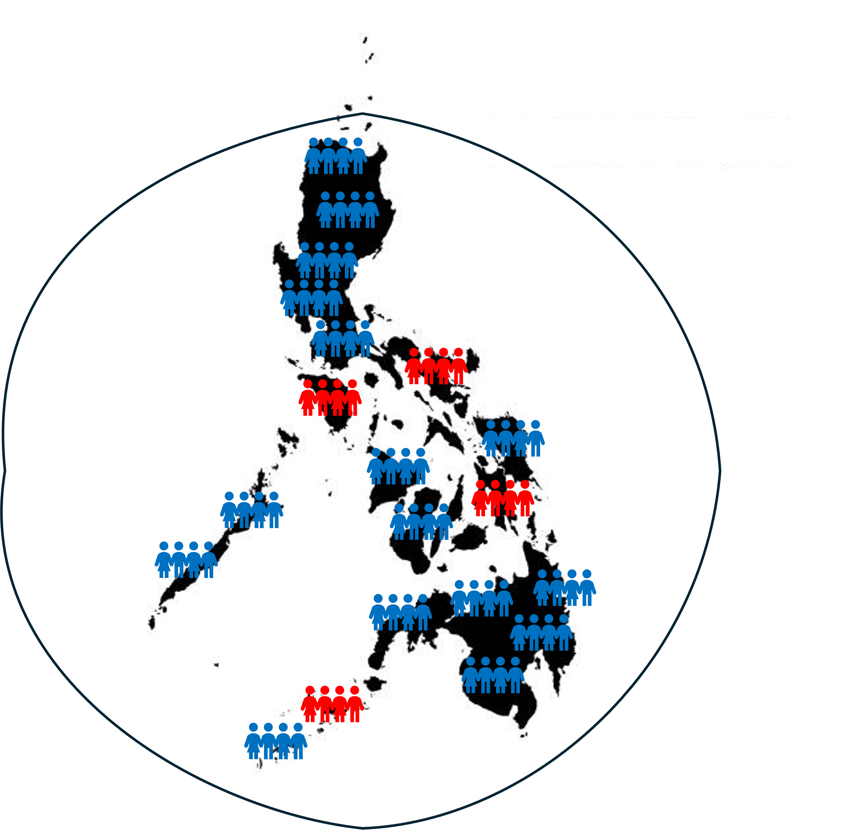


In each of these examples, we can use the data from our sample to draw
some conclusions about the object or people in the population.

Slide 19
In each of these examples, we can use the data from our sample to draw
some conclusions about the object or people in the population.

Slide 20
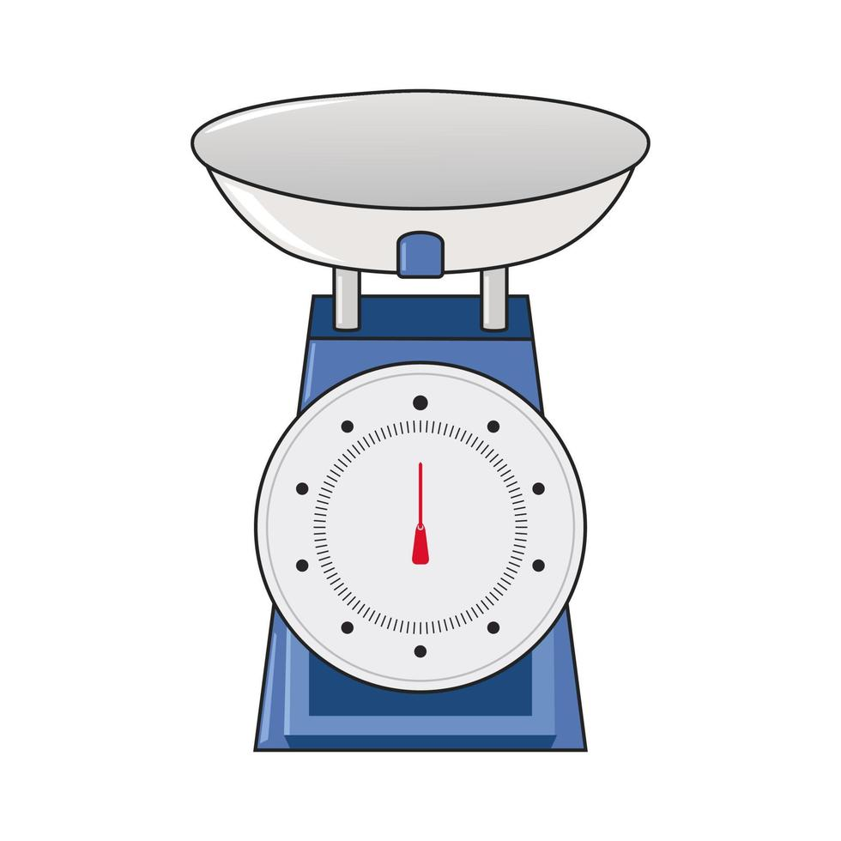
For example, we want to know about the weights of the mangoes in the orchard.

Slide 21
Sample mean = 3 kilograms
So, we take a sample of apples and weigh them

Slide 22
Sample mean = 3 kilograms
Population mean is about 3 kilograms
And use that information to draw conclusions about the
weights of mangoes in the whole orchard

Slide 23


3 Main Ideas Underlying Inference
1. A sample is likely to be a good representation of the population.
2. There is an element of uncertainty
as to how well the sample represents
the population.
3. The way the sample is taken matters.

Slide 24
3 Main Ideas Underlying Inference
1. A sample is likely to be a good representation of the population.
2. There is an element of uncertainty
as to how well the sample represents
the population.
3. The way the sample is taken matters.

Slide 25
1. A sample is likely to be a good representation of the population.
First, it is reasonable to expect that a sample of objects from a population
will represent the population

Slide 26
1. A sample is likely to be a good representation of the population.
If our orchard has only yellow mangoes of a fairly consistent size

Slide 27



1. A sample is likely to be a good representation of the population.
Then we would expect the sample to contain yellow mangoes
of a fairly consistent size.

Slide 28

1. A sample is likely to be a good representation of the population.
Yes
No
If 90% of the people in the Philippines
believe that the economy is getting worse

Slide 29
1. A sample is likely to be a good representation of the population.
Yes
No
Then about 90% of the sample will also believe that.

Slide 30
2. There is an element of uncertainty
as to how well the sample represents
the population.
Sample
Population
A sample will never be a perfect representation
of the population from which it is drawn

Slide 31
2. There is an element of uncertainty
as to how well the sample represents
the population.
Sample
Population
This is the reason for sampling error

Slide 32
2. There is an element of uncertainty
as to how well the sample represents
the population.
Sample
Population
A sampling error occurs when a sample is selected that is not representative
of the population being studied

Slide 33
2. There is an element of uncertainty
as to how well the sample represents
the population.
Sample
Population
A sampling error occurs when a sample is selected that is not representative
of the population being studied

Slide 34
2. There is an element of uncertainty
as to how well the sample represents
the population.
Pro-admin
Independent
For example, a political poll only surveyed people from a region
with a known political base.

Slide 35


2. There is an element of uncertainty
as to how well the sample represents
the population.
Nor will all samples drawn from the same population be the same.

Slide 36
2. There is an element of uncertainty
as to how well the sample represents
the population.
Nor will all samples drawn from the same population be the same.

